Slide 1


Enterprise Sales Engineer Summit: Hadoop

Slide 2


Outline

Slide 3
Outline
Part 1
Core Hadoop
Notes:
In Part 1, we’re going to take a pretty detailed look at what makes up the core of Hadoop and how each component works, both independently and within the system.

Slide 4
Outline
Part 1
Core Hadoop
Part 2
The Broader Ecosystem
Notes:
In Part 2, we’re going to take a step back and discuss a number of important technologies within the broader ecosystem that we encounter regularly. We’ll talk about their purpose and where they fit within the pipelines/stacks we often encounter. However, we won’t go into the same detail that we do in Part 1.

Slide 5
Outline
Part 1
Core Hadoop
Part 2
The Broader Ecosystem
Part 3
Practical Walkthrough
Notes:
Lastly, in Part 3, I’m going to step through a couple of examples that should act as a simple springboard for your own hands-on experimentation with Hadoop.

Slide 6
Preliminaries

Slide 7
Preliminaries
Before we dive into our conversation about Hadoop, let’s solidify some terms and technologies that creep up frequently.
Notes:
It’s almost impossible to discuss Hadoop without touching on fairly low-level engineering concepts, but we’ll try to keep this as high-level as possible.

Slide 8
Preliminaries
The Java Virtual Machine (JVM):

Slide 9
Preliminaries
The Java Virtual Machine (JVM):
Java is a compiled language (as opposed to an interpreted language).

Slide 10
Preliminaries
The Java Virtual Machine (JVM):
Java is a compiled language (as opposed to an interpreted language).
Java source code compiles into bytecode.

Slide 11
Preliminaries
The Java Virtual Machine (JVM):
Java is a compiled language (as opposed to an interpreted language).
Java source code compiles into bytecode.
Computers use the JVM to translate Java bytecode into low-level instructions that the hardware can understand.

Slide 12
Preliminaries
The Java Virtual Machine (JVM):
Java is a compiled language (as opposed to an interpreted language).
Java source code compiles into bytecode.
Computers use the JVM to translate Java bytecode into low-level instructions that the hardware can understand.
The JVM makes code portable. (Lot’s of languages can be compiled to run on the JVM.)
Notes:
Hadoop is written in Java. As such, it runs on the JVM. Moreover, most base interactions with Hadoop make use of its Java API, as we’ll see.

Slide 13
Preliminaries
The Java Virtual Machine (JVM):
Java is a compiled language (as opposed to an interpreted language).
Java source code compiles into bytecode.
Computers use the JVM to translate Java bytecode into low-level instructions that the hardware can understand.
The JVM makes code portable. (Lot’s of languages can be compiled to run on the JVM.)
The JVM loads separate classes on demand (as opposed to C, where compiled classes are fed into a class linker and output an executable).

Slide 14
Preliminaries
Other terms:
Daemon
Remote procedure call (RPC)
Notes:
Let’s cover some other terms that pop up frequently, just so we’re on the same page.
Daemon is a background process or application that runs on its own.
RPC is a API that, unlike REST, opens up remote procedures via single endpoint with additional information passed to call certain methods.

Slide 15
Part 1
Core Hadoop

Slide 16
Hadoop
What is Hadoop?
Notes:
In general terms, Hadoop is a distributed framework for storing and processing massive amounts of data.
Historically speaking, it lived in the realm of batch processing. However, since version 2, Hadoop can handle streaming and microbatch processes, which we’ll discuss in Part 2.

Slide 17
Core Hadoop
When we say “Hadoop,” we’re talking about three core components:

Slide 18
Core Hadoop
When we say “Hadoop,” we’re talking about three core components:
Hadoop Distributed Filesystem (HDFS)

Slide 19
Core Hadoop
When we say “Hadoop,” we’re talking about three core components:
Hadoop Distributed Filesystem (HDFS)
Yet Another Resource Negotiator (YARN) - Hadoop v2

Slide 20
Core Hadoop
When we say “Hadoop,” we’re talking about three core components:
Hadoop Distributed Filesystem (HDFS)
Yet Another Resource Negotiator (YARN) - Hadoop v2
MapReduce

Slide 21
Core Hadoop
HDFS, YARN, and MapReduce handle the following aspects of the platform, respectively:
File storage
Resource and application management
Computation

Slide 22
Core Hadoop: HDFS
Notes:
HDFS is the storage mechanism for Hadoop. In certain respects, it’s similar to the filesystem we often navigate when using a linux system. But there are some key differences which we’ll discuss. HDFS is fundamentally different from RDBMS in that it utilizes a schema-on-read paradigm versus schema-on-write. That is to say, HDFS can store nearly any file type without regard for its structure or data types. It’s just a system of containers that hold stuff. RDBMS requires that our data be in a particular (tabular) format at the time of writing. With Hadoop, our schema occurs at the time of transformation and it is ephemeral by its very nature.

Slide 23
Core Hadoop: HDFS
HDFS is similar to the filesystem on a PC, in that it stores data in “blocks” on disk.
Notes:
Blocks can be thought of as discrete units of storage on disk. If we used a pile of sand as a physical representation for a file containing data, we would pour our sand into many buckets of identical size to store our data.

Slide 24
Core Hadoop: HDFS
Unlike a standard filesystem, however, HDFS has much larger blocks. Also, partially full blocks do not wastefully claim disk space.
Notes:
Blocks on standard filesystems allocate 512 bytes, whereas HDFS blocks have a default of 128 megabytes. Moreover, 400 bytes on a standard block leaves 112 bytes allocated on disk but not utilized. HDFS would only allocate 400 bytes on disk.
Larger, contiguous blocks help with seek time and can improve performance.

Slide 25
Core Hadoop: HDFS
Of course, HDFS is distributed. As such, there are many blocks to one disk, many disks to one machine, and many machines to one cluster.

Slide 26
Core Hadoop: HDFS
A Hadoop cluster is comprised of at least one namenode (master) and datanodes (workers).
Notes:
This is similar to many distributed frameworks we encounter. There’s almost always a machine dedicated to orchestration or planning, while all other machines are task oriented and do most of the processing. What makes Hadoop, and HDFS in particular, different from other computing paradigms is that there is no central data store where workers have to go to get data in order to process or to do intermediate writes. Instead, as many aspects of the computer framework are distributed and can be executed locally.

Slide 27



Core Hadoop: HDFS
fsimage, edit log, other metadata
Some mysterious process
Namenode
SecondaryNamenode
a.log (384mb)
Datanode
Datanode
Replicate
Replicate
Datanode filesystem
Datanode filesystem
Split into block-sized chunks
Blocks
Blocks
Notes:
When a file is written to HDFS, it is first partitioned into block size chunks, the data then streams into the first set of blocks in a datanode, upon completion the blocks are replicated and pushed on to subsequent datanodes (3 times by default). At each stage, the datanodes broadcast status updates back to the namenode which are logged in the edit log.
Data replication is interesting, not only because it improves fault tolerance, but because having multiple copies of the data on different machines means processes can grab the closest copy, improving performance.
The master node contains the network’s filesystem tree as well as other metadata. It persists this information in local memory.
Historically speaking, the master node was not set-up for high availability; however, Hadoop 2 introduced a standby master node that can be swapped out for the original in the presence of a failure. The standby is also in charge up take edits from the log and updating the filesystem image, which it then pushes upstream to the default namenode so that it always has the most up-to-date image without taking a hit in memory to update the image itself.

Slide 28
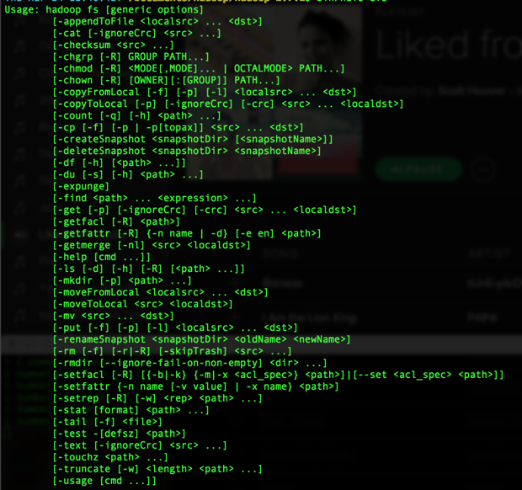
Core Hadoop: HDFS
Notes:
There are a number of clients that allow us to interface with HDFS. The most accessible is perhaps the command-line interface, which supports many familiar operations we use in terminal. In addition to the command-line client, there are also Java and REST APIs.

Slide 29
Core Hadoop: HDFS
Example…
$ echo hello my name is scott > hdfs_test.txt
$ hdfs dfs -mkdir /user
$ hdfs dfs -mkdir /user/scott/
$ hdfs dfs -put hdfs_test.txt /user/scott/hdfs_test.txt
$ hdfs dfs -ls /user/scott/
> Found 1 items -rw-r--r-- 1 scott supergroup 23 2016-04-08 12:52 /user/scott/hdfs_test.txt

Slide 30
Core Hadoop: HDFS
The previous example was on my local in standalone mode. A minor modification is made when performing operations on a cluster:
$ hdfs dfs -put example.txt /user/scott/example.txt
Becomes
$ hdfs dfs -put example.txt hdfs://namenode_host:port/user/scott/example.txt
Notes:
Of course, we’re demonstrating ad hoc interactions with the filesystem, but there are specific tools that utilize these APIs on a much larger scale which we’ll discuss in Part 2.

Slide 31
Core Hadoop: HDFS
What does HDFS do in this case?
Our client calls create() on the DistributedFileSystem class.
This method requests that the namenode create a namespace for the file, if one doesn’t already exist.
Then the FSDataOutputStream class requests that the namenode allocate blocks across datanodes to which the file will be written.
The data streams into the first set of blocks on a datanode.
Upon completion, the datanode forwards its stream to 2 or more datanodes for replication.
Once replication is complete, the connection to the datanodes is closed.
A job status of complete is logged on the namenode.

Slide 32
Core Hadoop: HDFS
File compression helps save space and also reduces the load imposed on the network, which is perhaps the most scarce resource in the cluster.

Slide 33
Core Hadoop: HDFS
HDFS handles the following compression types:
Compression Type | Splittable? | Speed-size tradeoff
gzip | No | Balanced
bzip2 | Yes | Size
snappy | No | Speed
lzo | No | Speed
lz4 | No | Speed
Notes:
As files are written to or read from HDFS, they can be compressed. By compressing a file, we reduce the amount of storage needed, and we create a smaller file that has to be sent across the network. The tradeoff is that the process of compressing a file takes time, thus slowing IO.

Slide 34
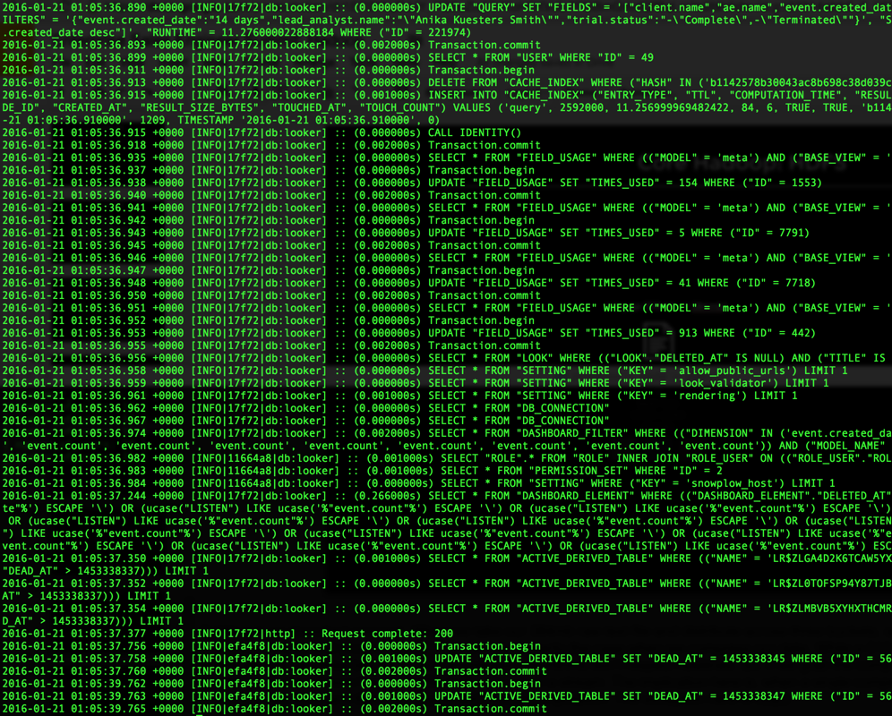
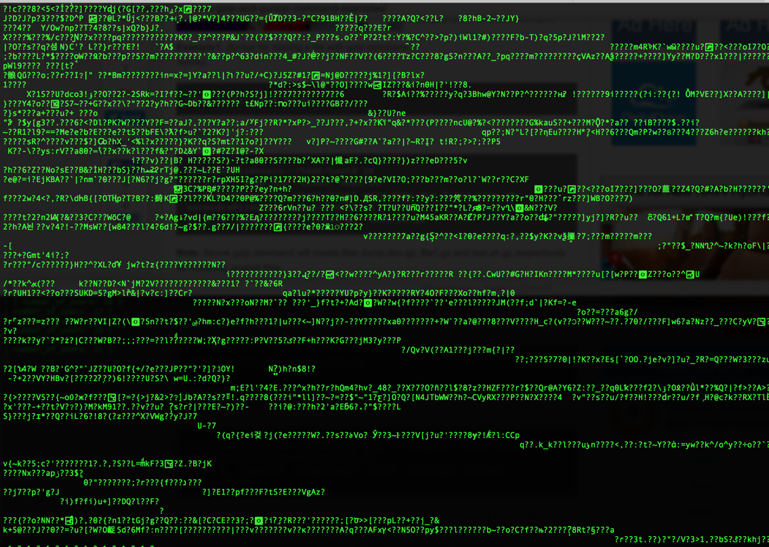
Core Hadoop: HDFS
a.log in its raw format
a.log.gz in its compressed format
a.log.gz (512mb => 384mb)
Split into block-sized chunks
Notes:
Splitting is an important concept. When we take our 384mb raw text file and distribute across three buckets, three different MapReduce tasks can grab those independent files and process them. This isn’t necessarily the case when we compress our data. While a 512mb file might compress down to 384mb and be distributed across three blocks, most compression algorithms don’t respect newlines.
So, if we grab the compressed file from a bucket, uncompress it, there’s no guarantee that we haven’t split this file in the middle of a stream. The implication here is, when a single compressed file has to be split into blocks, those blocks need to be re-assembled and decompressed before computation. The exception here is bzip2.

Slide 35
Core Hadoop: HDFS
Key takeaways:
HDFS is the means by which data is stored within Hadoop
Like a standard filesystem, it persists data on disk
Unlike a standard filesystem, it stored data in relatively large blocks
Unlike a standard filesystem, data is redundant and distributed across numerous physical machines
HDFS uses low-level protocols that run on the JVM all of which handle I/O
HDFS will “self-heal” by detecting and repairing corrupt blocks

Slide 36
Core Hadoop: YARN
Notes:
YARN is new to Hadoop v2. In Hadoop v1, some of the features of YARN were absent, while others were handled by MapReduce itself.
Todd: In Hadoop v2: the resource management features of MapReduce were abstracted out so that other applications could be run. MapReduce was rewritten to be the default application.

Slide 37
Core Hadoop: YARN
YARN handles two principal aspects of Hadoop:
Resource management
Application management

Slide 38
Core Hadoop: YARN
The Resource Manager (RM)
Notes:
When a MapReduce job is submitted, YARN’s Resource Manager assesses the necessary resources of the submitted job. It then goes out to the cluster and determines the available resources. Lastly, it solves an optimization problem aimed at providing all of the applications running on the cluster the resources they need complete. This is subject to various constraints, rules, and parameters, most of which are configurable. In short, the RM figures out when to do stuff and where.
Provide a few example parameters and rules.
The Resource Manager is the only global entity YARN creates.

Slide 39
Core Hadoop: YARN
The Application Manager or Master (AM)
Notes:
The Application Manager/Master negotiates resources from the Resource Manager and works with NodeManagers to deploy and monitor application containers and their resource consumption.
Todd: Resources are allocated based on available cores and RAM.

Slide 40
Core Hadoop: YARN
NodeManagers
Notes:
The NodeManager is the per-machine slave, which is responsible for actually launching the application containers, monitoring their resource usage (cpu, memory, as well as disk and network io) and reporting this back to the ResourceManager.

Slide 41
Core Hadoop: YARN
MapReduce
YARN
HDFS
Worker 1
Node Manager
Application Master
Node status
Resource request
Worker 2
Worker 1: filesystem
Job issued from client, e.g., MapReduce
Job submitted
MapReduce updates
Resource Manager
Node status
Node Manager
Application Container
I/O
Node status
Worker 3
Worker 2: filesystem
Node Manager
Application Container
I/O
Notes:
1. A job is submitted
2. The resource manager requests and update to assess available resources and to optimize accordingly.
3. Certain datanodes with the necessary resources get application containers.
4. One datanode gets spun up with the application master.
5. The nodemanagers on each machine actually launch the application processes.
6. As the MapReduce tasks go, they update the application master.
7. Node managers send job updates back to the resource manager.
8. All the while, application containers are reading and writing to and from blocks on disk.

Slide 42
Core Hadoop: YARN
YARN also handles job scheduling. There are a few options:
First in, first out (FIFO)
Fair
Capacity
Notes:
FIFO is a naive queue. The drawback is if a long-running job enters the queue, it’ll hog resources. So smaller jobs that could execute quickly have to wait.
Fair dynamically allocates resources across all running jobs.
Capacity makes use of dedicated queues with certain allotments of resources. So, small jobs may get a dedicated queue so that they can execute tasks right away, however, they have a fixed amount of resources. Also, this means that empty queues reserve resources.

Slide 43
Core Hadoop: YARN
With YARN, we basically get more of everything:
Scale
Efficiency
Concurrency
Multi-tenancy/applications
Notes:
Scale: MapReduce on Hadoop v1 hit its bottleneck around 4,000 nodes and 40,000 tasks. This was because MapReduce’s naïve jobtracker basically had to handle job scheduling and task management. YARN helps Hadoop scale to about 10,000 nodes and 100,000 tasks.
Efficiency: YARN improves upon the resource-utilization model by optimizing all applications using a pool of resources, whereas MapReduce on Hadoop v1 basically had allocated slots for each application.
Concurrency: It follows from the above two points that that concurrency is also improved.
Applications: While YARN is part of Hadoop’s core, it actually opens up Hadoop to distributed applications other than MapReduce. This is why when we talk about Hadoop these days, we’re folding in an ever-growing list of technologies that run on top of YARN.

Slide 44
Core Hadoop: YARN
Pig
Hive
HBase
Metastore
Related projects in the ecosystem (e.g., Cassandra)
MapReduce
HDFS
Notes:
This was the local ecosystem with Hadoop v1

Slide 45
Core Hadoop: YARN
Pig
Hive
Other YARN frameworks (e.g., Spark, Tez)
Metastore
Non-relational data stores (e.g., HBase)
Related projects in the ecosystem (e.g., Kafka, Cassandra, ZooKeeper)
MapReduce
YARN
HDFS
Notes:
This is the local ecosystem with Hadoop v2

Slide 46
Core Hadoop: YARN
Key takeaways:
Handles scheduling
Handles resource management
Handles task management
Improves scale
Improves efficiency and cluster utilization
Opens Hadoop up to non-MapReduce frameworks

Slide 47
Core Hadoop: MapReduce
Notes:
“MapReduce” can actually refer to two things: the programming model that outlines how to do a parallel computation and the implementation of a parallel computation. We’ll first cover the implementation, then briefly the programming model, and then dovetail these concepts with what we covered in the previous subsections to get 10,000-foot view of the entire process.

Slide 48
Core Hadoop: MapReduce
From the previous section, we saw that there are five high-level components that make up a MapReduce job:
The client from which the job is submitted;
The ResourceManager, which allocates cluster resources;
The NodeManager(s), which launch and monitor application containers;
The ApplicationMaster, which coordinates MapReduce tasks;
HDFS, which shares files between the various job processes.

Slide 49
Core Hadoop: MapReduce
Upon job submission, the submit() method calls up the JobSubmitter class which :
Asks the ResourceManager for a new application ID;
Makes sure the output destination was specified and doesn’t already exist;
Computes the splits for the input file(s);
Copies the resources needed for the job (e.g., splits, JAR, config) with the aforementioned job id to various datanodes;
The final SubmitApplication() method is called and the ResourceManager takes over.

Slide 50
Core Hadoop: MapReduce
Next, YARN handles job initialization, specifically :
The ResourceManager launches the Application Master (AM);
The AM receives the input splits;
For each split, the AM creates a map task as well as a reduce task;
The AM assigns each task to an existing or new JVM, depending on the size and complexity of the job;
The AM creates the output and temp directories for the the job.

Slide 51
Core Hadoop: MapReduce
Next, YARN handles task assignment, specifically :
For each task (map tasks holding the higher priority) the AM requests a container;
In each request, the AM specifies CPU and memory requirements for the individual task.
Note: The Resource Manager tries to place tasks on the same physical machine as the data that they’ll will be working on.

Slide 52
Core Hadoop: MapReduce
Lastly, the tasks are executed:
We’re in a state where each task has a container with physical resources;
The AM then requests that the NodeManager fire up the container, effectively launching the (map or reduce) task;
During task execution, containers report progress to AM, which is then relayed to the ResourceManager.

Slide 53
Core Hadoop: MapReduce
So what does a MapReduce task entail, precisely?

Slide 54
Core Hadoop: MapReduce
Map Phase
Copy Phase
Sort and Shuffle Phase
Reduce Phase
Reduce function
Map function
Partition, split, spill to disk
merge
Input split
f(x)
Buffer in memory
Merge on disk
g(x)
Output
merge
merge
Remote map tasks
Remote reduce tasks
Chart borrowed-ish from “Hadoop: The Definitive Guide”, pg.197

Slide 55
Core Hadoop: MapReduce
Let’s use the canonical word-count example to demonstrate.

Slide 56
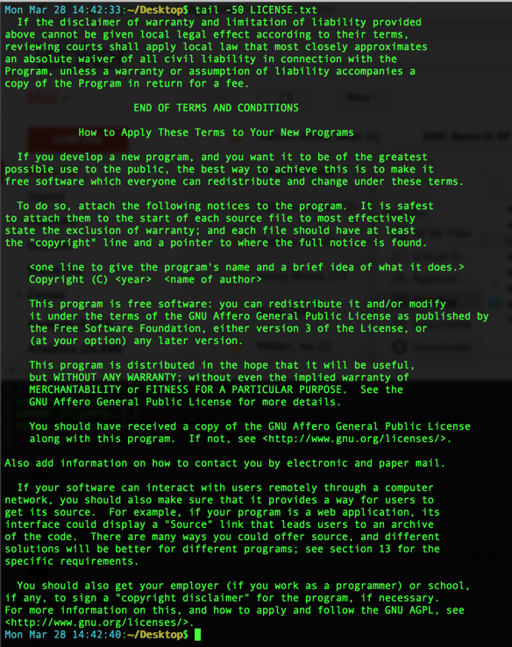
Core Hadoop: MapReduce
Notes:
Let’s suppose we have a file with a stream of text.

Slide 57
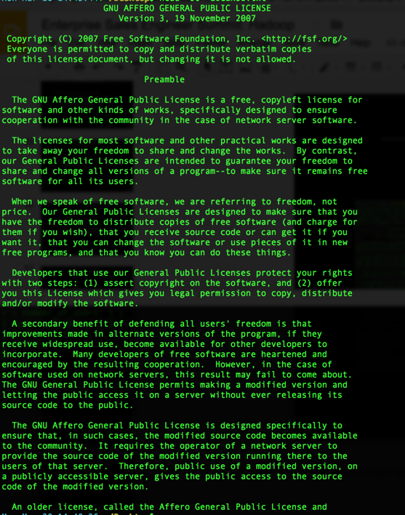
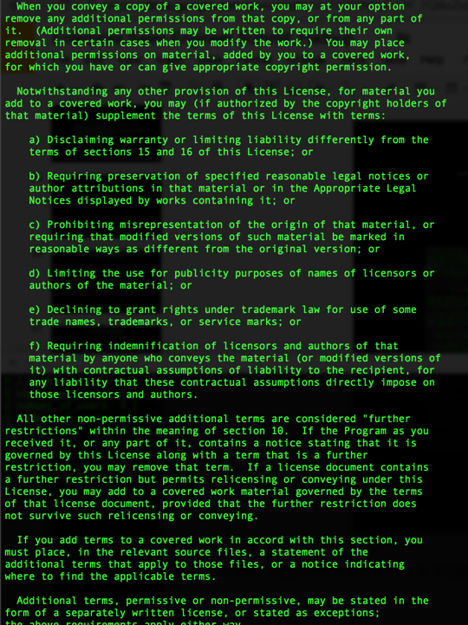
Core Hadoop: MapReduce
example.txt
hdfs dfs -put example.txt /user/scott/example.txt
Replication
Block 1
Block 33
Block 97
Machine 1
Machine 3
Machine 9
Notes:
Let’s also suppose that the file is large enough to be stored in multiple blocks in HDFS.
As we’ve seen, when we load into HDFS, the file is split, distributed to blocks, and then replicated at least twice.

Slide 58
Core Hadoop: MapReduce
Let’s trace the following stream of text from example.txt through our MapReduce algorithm.
“the gnu affero general public license is a free copyleft license for\\n”
Notes:
The newline character is explicitly included for clarification. This would not be parsed.

Slide 59
Core Hadoop: MapReduce
Hadoop is going to make things simple for us. It has a default InputFormat setting. As a stream makes its way to the mapper from a block in HDFS, it sends (byte_offset, single_line_of_text) in key-value format.
This way our mapper doesn’t have to handle a multi-line blob of text as input—i.e., the entire block. Instead, it just needs to handle a key-value pair, where the value is a single line of text and the key is basically ignored.
So, one map task would get the following as input:
(10, “the gnu affero general public license is a free copyleft license for”)

Slide 60
Core Hadoop: MapReduce
function mapper(key: Integer, value: Text) {
// split stream of text on blank spaces
words = value.split(“\\s+”)
foreach word in words {
return Tuple(word, 1)
}
}

Slide 61
Core Hadoop: MapReduce
Which would return:
(the, 1)
(gnu, 1)
(affero, 1)
(general, 1)
(public, 1)
(license, 1)
(is, 1)
(a, 1)
(free, 1)
(copyleft, 1)
(license, 1)
(for, 1)
Notes:
So, a

Slide 62
Core Hadoop: MapReduce
However, Hadoop has a sort-and-shuffle phase which it performs automatically:
Map Output
Sort
Shuffle
(the, 1)
(gnu, 1)
(affero, 1)
(general, 1)
(public, 1)
(license, 1)
(is, 1)
(a, 1)
(free, 1)
(copyleft, 1)
(license, 1)
(for, 1)
(a, 1)
(affero, 1)
(copyleft, 1)
(for, 1)
(free, 1)
(general, 1)
(gnu, 1)
(is, 1)
(license, 1) (license, 1)
(public, 1)
(the, 1)
(a, [1])
(affero, [1])
(copyleft, [1])
(for, [1])
(free, [1])
(general, [1])
(gnu, [1])
(is, [1])
(license, [1,1])
(public, [1])
(the, [1])
Notes:
So, a

Slide 63
Core Hadoop: MapReduce
function reducer(key: String, value: Array[Int]) {
// define occurrences as a zeroed-out accumulator
occurrences = 0
foreach i in value {
occurrences += i
}
return Tuple(key, occurrences)
}

Slide 64
Core Hadoop: MapReduce
Finally, our reducer takes Text as its key and an Array as its value, and returns the key and a sum of the value.
(a, 1)
(affero, 1)
(copyleft, 1)
(for, 1)
(free, 1)
(general, 1)
(gnu, 1)
(is, 1)
(license, 2)
(public, 1)
(the, 1)

Slide 65
Core Hadoop: MapReduce
That’s it!
We started by defining a larger problem for which we wrote a MapReduce job (pseudocode).
Then we stepped through one task (i.e., parsing a single line) associated with our overall job.
Keep in mind, though, that our job was to parse an entire file.
As such, this one job would be associated with many tasks, or application containers, orchestrated by an Application Master; these containers run on different datanodes in our cluster, each of which has a nodemanager that constantly reports to YARN’s ResourceManager.
Notes:
So, a

Slide 66
Core Hadoop: MapReduce
Key takeaways:
The term “MapReduce” carries with it two related but different concepts:
MapReduce code, using an API, defines some functional computation—i.e., a logical unit of work.
The implementation of MapReduce refers to the physical instance of the aforementioned unit of work, running on a JVM, coordinating with its Application Master.
MapReduce is a low-level framework, typically requiring Java knowledge, though there have been higher-level abstractions introduced over time—e.g., Pig, Hive, Mr. Job (Python), etc.
MapReduce is inherently a batch-processing tool.
MapReduce has limitations: it’s obviously a poor choice for low-latency pipelines, and it can’t handle iterative algorithms often encountered in machine learning.
Notes:
Todd: MapReduce is like assembly, Pig, Hive are more like scripting languages

Slide 67
Core Hadoop
In closing:
HDFS is the means by which data is stored in Hadoop. It’s similar to the type of filesystem we often use, but handles massive scale in a distributed fashion.
YARN is new to Hadoop v2, and handles scheduling, as well as resource and application management for Hadoop jobs. YARN opens up Hadoop to new, non-MapReduce compute frameworks and it improves both efficiency and performance of applications.
MapReduce is the batch-processing framework for Hadoop. We interface with APIs to define logical units of work, and the process is implemented on YARN and HDFS.
For more detail on the topics covered see:
Hadoop: The Definitive Guide by Tom White (chs. 1-9)
Hadoop Operations by Eric Sammer (chs. 1-3)
Notes:
Todd: You can see why batch processing/MapReduce is being supplanted by in-memory, interactive frameworks like Spark.

